Slide 1
Accept or reject clients’ loan applications?
By: Jezen Alexander

Slide 2
Outline
Data
Appropriate Method for Modeling
Data Prep/Cleaning
Model and Results
Simulations to Minimize Loss
Conclusions
Strengths and Weaknesses

Slide 3


data
Over 300,000 clients’ information and 122 variables
Posted in Kaggle by Home Credit Group in 2018 [6]
Home Credit Group is a loan provider which operates in different countries including U.S. [1]

Slide 4
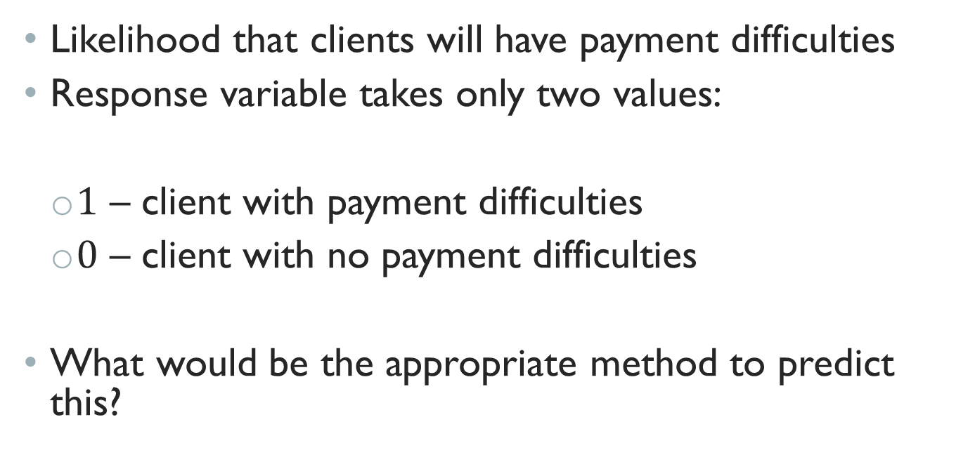
prediction
Likelihood that clients will have payment difficulties
Response variable takes only two values:
$1$ – client with payment difficulties
$0$ – client with no payment difficulties
What would be the appropriate method to predict this?

Slide 5
Logistic Regression
Models…
Predict response variables that are categorical (I.e. True or False, Yes or No)
Give fitted values between 0 and 1 through some transformations [2]

Slide 6
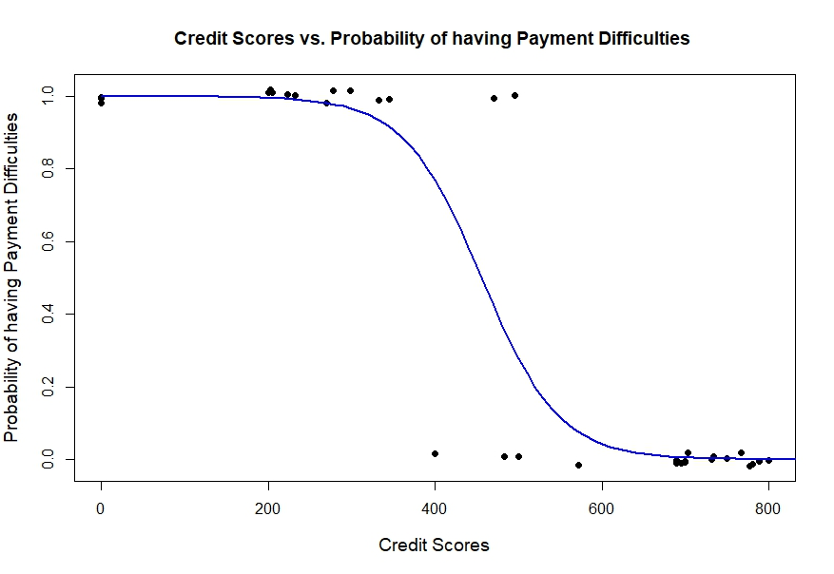
Logistic Regression
Models…
Predict response variables that are categorical (I.e. True or False, Yes or No)
Give fitted values between 0 and 1 through some transformations [2]
Note that the values used to create the above plot are arbitrary for illustration purposes

Slide 7
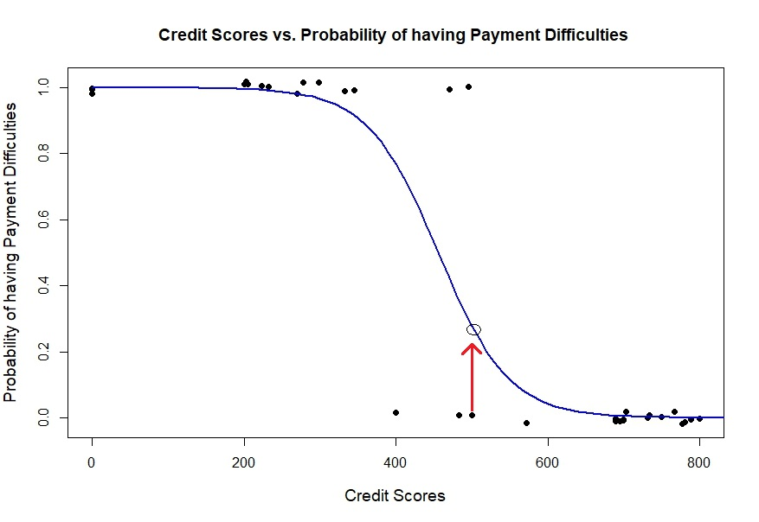
Logistic Regression
Models…
Predict response variables that are categorical (I.e. True or False, Yes or No)
Give fitted values between 0 and 1 through some transformations [2]
Can be used to make classifiers by choosing a cutoff/threshold value
Note that the values used to create the above plot are arbitrary for illustration purposes

Slide 8
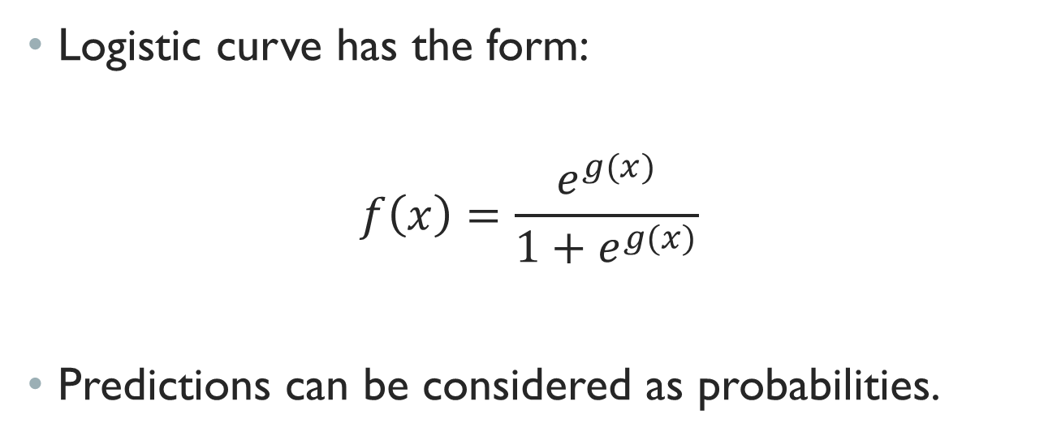
Logistic Regression
Logistic curve has the form:
$$f\left(x\right)=\frac{e^{g(x)}}{1+e^{g(x)}}$$
Predictions can be considered as probabilities.

Slide 9
Data Prep/Cleaning
Excluded variables with too many missing data
Replaced missing values with average
Converted categorical variables such as family status, house type, education level and more, into numeric

Slide 10
Data Prep/Cleaning
Correlations (Chose top 10 most correlated variables)
Proportion tables

Slide 11
Data Prep/Cleaning
Correlations (Chose top 10 most correlated variables)
Proportion tables
 | Higher Education | Lower Education
No Payment Difficulties | 200,000 | 10,000
Payment Difficulties | 10,000 | 30,000
Note that the values above are arbitrary for illustration purposes

Slide 12
Data Prep/Cleaning
Split the dataset:
70% - Training (For modeling)
30% - Testing (For testing performance)
A standard rule of thumb [7]

Slide 13
Final Model
Variables included in the Final Model:
LoanType – Revolving or Cash
Gender – Clients’ gender
RegRating – Home Credit’s rating of the region where clients live
EmpPhone – Reachable? Do clients really work there?
LiveMatch – Does permanent address match?
Scores – Clients’ credit scores
Age – Clients’ age
Def – Observations of clients’ surrounding defaulted on 30 days past due
Secondary – Do clients finished secondary level of education?
DaysId – How many days before application did clients change identity document
DaysPhone – No. of days before application did clients change phone

Slide 14
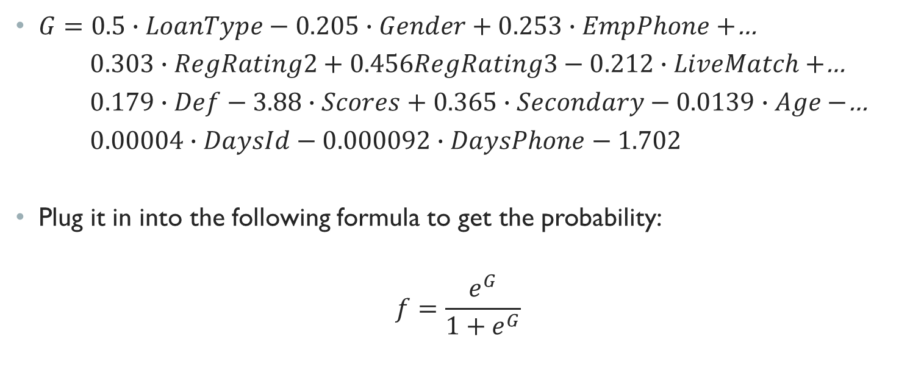
Final Model
$G=0.5∙LoanType−0.205∙Gender+0.253∙EmpPhone+$…
$0.303∙RegRating2+0.456RegRating3−0.212∙LiveMatch+$…
$0.179∙Def−3.88∙Scores+0.365∙Secondary−0.0139∙Age−$…
$0.00004∙DaysId−0.000092∙DaysPhone−1.702$
Plug it in into the following formula to get the probability:
$$f=\frac{e^{G}}{1+e^{G}}$$

Slide 15
Performance of the Model
At 0.5 (Default) Threshold level:
 | Predicted: No | Predicted: Yes
Actual: No | 94,199 | 2
Actual: Yes | 8,292 | 3

Slide 16
Performance of the Model
At 0.5 (Default) Threshold level:
 | Predicted: No | Predicted: Yes
Actual: No | 94,199 | 2
Actual: Yes | 8,292 | 3

Slide 17
Performance of the Model
At 0.5 (Default) Threshold level:
At 0.25 Threshold level:
Reducing threshold increases the errors, but it’s able to predict more people with payment difficulties
 | Predicted: No | Predicted: Yes
Actual: No | 94,199 | 2
Actual: Yes | 8,292 | 3
 | Predicted: No | Predicted: Yes
Actual: No | 92,698 | 1,503
Actual: Yes | 7,679 | 616

Slide 18
Now, the problem is…
Is it worth rejecting some clients who are capable of paying the loans in order to reduce the approvals of risky clients?
Certainly, having clients default on their loans are costly for the loan providers
Rejecting capable clients means they lose the opportunity to gain profits

Slide 19
Now, the problem is…
Is it worth rejecting some clients who are capable of paying the loans in order to reduce the approvals of risky clients?
Certainly, having clients default on their loans are costly for the loan providers
Rejecting capable clients means they lose the opportunity to gain profits
According to some experts, banks or loan providers can become insolvent when too many of their borrowers default [9]

Slide 20
Assumptions
Need to make assumptions on the potential loss
What would be the potential amount loss if:
Simulations on these three cases
Loss from rejecting a capable client ($) | Loss from a client who default ($)
1,000 | 3,000
1,000 | 5,000
1,000 | 10,000

Slide 21
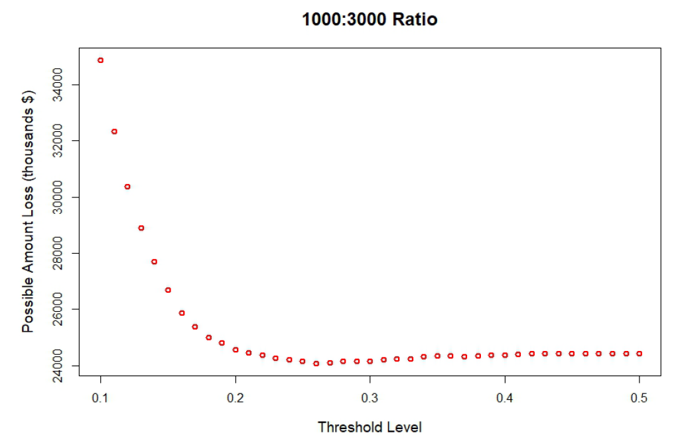
When the loss is 1000 : 3000

Slide 22
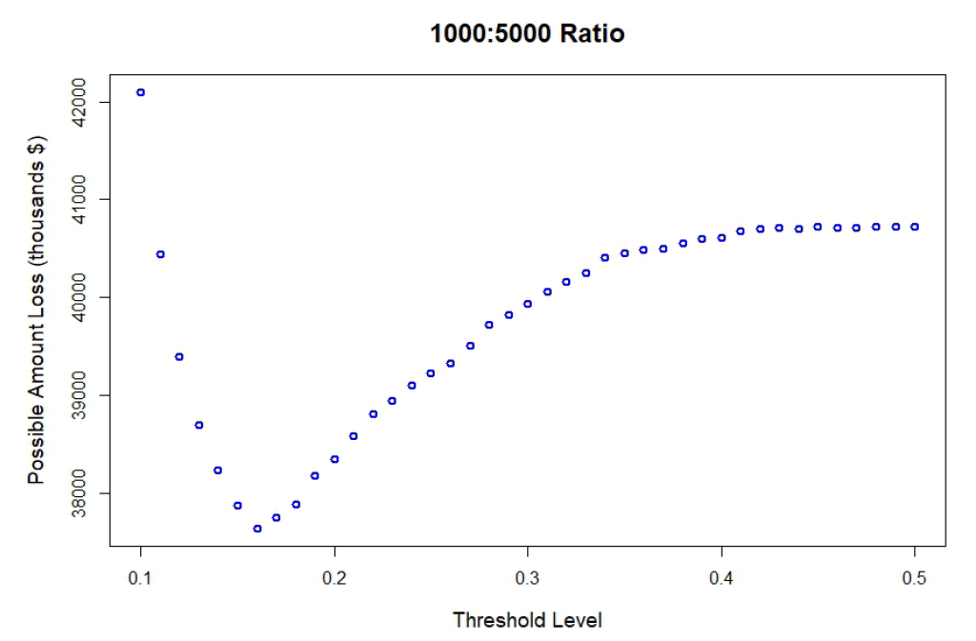
When the loss is 1000 : 5000

Slide 23
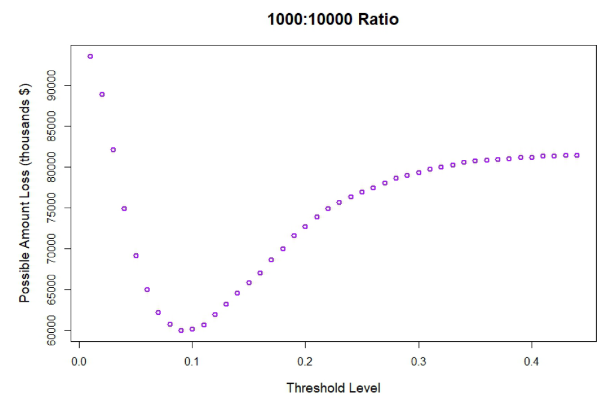
When the loss is 1000:10000

Slide 24
Conclusion
Threshold level plays an important role in logistic regression.
Some errors are more costly than the others
Depending on the possible amount that they may lose from rejecting capable clients and accepting risky clients, they may have to decide on different threshold level. For instance,

Slide 25
Conclusion
Threshold level plays an important role in logistic regression.
Some errors are more costly than the others
Depending on the possible amount that they may lose from rejecting capable clients and accepting risky clients, they may have to decide on different threshold level. For instance,
Loss from rejecting a capable client ($) | Loss from a client who default ($) | Threshold level that minimizes loss
1,000 | 3,000 | 0.26
1,000 | 5,000 | 0.16
1,000 | 10,000 | 0.09

Slide 26
Strengths & Weaknesses
Big data, provide greater insights
Program that can be used to minimize loss. Once the average amount loss is known, just plug it in into the program and a nice plot showing which threshold level to choose is shown.
Imbalance dataset
Variable selections
Model can only be applied to Home Credit Group or other loan providers who are similar to them

Slide 27
REFERENCES
[1] About us. (n.d.). Retrieved April 19, 2019, from http://www.homecredit.net/about- us.aspx
[2] Cannon, A. R., Cobb, G. W., Hartlaub, B. A., Legler, J. M., Lock, R. H., Moore, T. L., Witmer, J. A. (2013). Logistic Regression. In STAT2: Building Models for a World of Data (pp. 449-580).
New York: W.H. Freeman.
[3] Cannon, A. R., Cobb, G. W., Hartlaub, B. A., Legler, J. M., Lock, R. H., Moore, T. L., Witmer, J. A. (2013). Multiple Regression. In STAT2: Building Models for a World of Data (pp. 95-149).
New York: W.H. Freeman.
[4] Class Imbalance Problem. (2013, August 30). Retrieved from http://www.chioka.in/class-imbalance-problem/
[5] Faraway, J. J. (2016). Binary Response. In Extending the linear model with R: Generalized linear, mixed effects and nonparametric regression models (pp. 25-44). Boca Raton: CRC Press.
[6] Home Credit Default Risk. (2018, May 17). Retrieved from https://www.kaggle.com/c/home-credit-default-risk/data
[7] Kotu, V., & Deshpande, B. (2015). Data Mining Process. In Predictive Analytics and Data Mining: Concepts and Practice with RapidMiner (pp. 17-34). Amsterdam: Elsevier/Morgan Kaufmann.
[8] Kotu, V., & Deshpande, B. (2015). Regression Methods. In Predictive Analytics and Data Mining: Concepts and Practice with RapidMiner (pp. 165-180). Amsterdam: Elsevier/Morgan
Kaufmann.
[9] Ryan-Collins, J., Greenham, T., Werner, R., & Jackson, A. (n.d.). How do Banks Become Insolvent? Retrieved from https://positivemoney.org/how-money- works/advanced/how-do-banks
become-insolvent/

Slide 28
Acknowledgements
John Z. Hossler, Ph.D.
Brian T. Gill, Ph.D.

Slide 29
Thank you! Questions?

